Slide 1
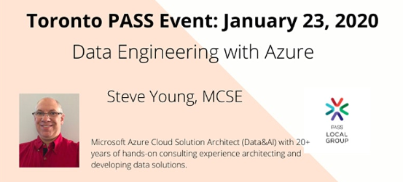
Data Engineering with Azure
Steve Young - Data & AI CSA (Microsoft)
styoung@Microsoft.com
http://5minutebi.com
http://linkedin.com/in/steveyoung/
January 23, 2020

Slide 2
Objectives
Introduction
What is Data Engineering
Notes:
Azure Overview
SQL DW Overview
Some Important features,

Slide 3
What is Data Engineering
Notes:
Before we go too far into the tool
Lets cover the environment that SQL DW operates

Slide 4
Where Did I start?
- Story about the Excel
Notes:
Data Engineer seems to have different definitions depending on if you are talking about stictly data or data science.
Guess what, if you are the person people point at if there is somethign is wrong with data in your organization, guess what, you are a Data Engineer.
Wether you are on prem, in the cloud or some where in between, you are a data engineer

Slide 5


Where Did I start?
Gather
Ingest
Store
Prepare
Distribute
Files
(Reports / Printouts)
Printer
Data Entry Analyst
Excel
Notes:
Data Engineer seems to have different definitions depending on if you are talking about strictly data or data science.
Guess what, if you are the person people point at if there is something is wrong with data in your organization, guess what, you are a Data Engineer.
Whether you are on prem, in the cloud or some where in between, you are a data engineer

Slide 6


hub & Spoke architecture for bi
Gather
Ingest
Store
Prepare & Train
Model & Serve
Data Marts
Business/custom apps
(structured)
SQL
Azure Databricks
Multiple Azure SQL Database instances
Logs (unstructured)
PolyBase
Azure Data Factory
Azure Blob Storage
Azure SQL Data Warehouse
Power BI
Media (unstructured)
Data Cubes
Azure Data Factory
Multiple Azure Analysis Services instances
Files (unstructured)
Notes:
SQL DW as the hub Cubes are the spike
Siloed data marts can lead to incomplete information and additional headcount cost.
A monolithic data warehouse has inherent limits.
hub-and-spoke architecture where SQL Data Warehouse acts as a hub for the data marts.
Integrate Azure Functions to fully leverage the elasticity of SQL Data Warehouse with autoscale capabilities.
Key – All queryes are answered in a timely fashion.
Not all queries are created equal
Do you need the power of MPP?
Subject area data marts, Cubes for Power BI

Slide 7
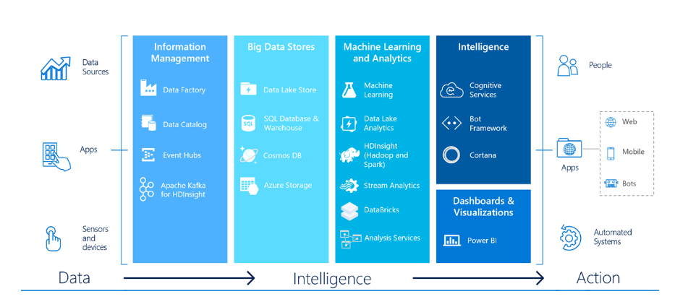
Azure Data Platform
Notes:
Data Engineer seems to have different definitions depending on if you are talking about stictly data or data science.
Guess what, if you are the person people point at if there is somethign is wrong with data in your organization, guess what, you are a Data Engineer.
Wether you are on prem, in the cloud or some where in between, you are a data engineer

Slide 8






























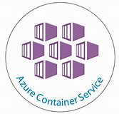






















We now have many different tools → Open Source
DevOps
Management
Applications
App frameworks
& tools
Databases &
middleware
Infrastructure

Slide 9
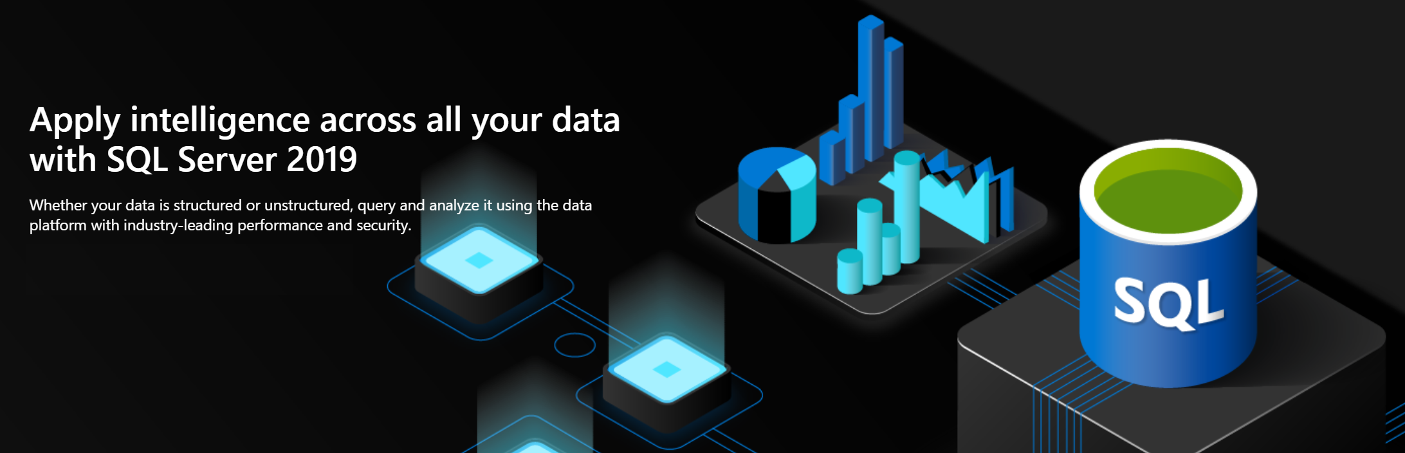
We now have many different tools → Open Source
DevOps
Management
Applications
App frameworks
& tools
Databases &
middleware
Infrastructure

Slide 10





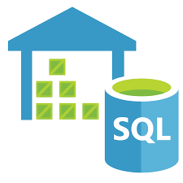
Azure Data Modernization Choices
WWI
SQL Server 2016
SQL Server 2017
SQL Server 2019
SQL
SQL Server in
Azure Virtual Machine (IAAS)
SQL
SQL Server 2008
SQL Server 2008R2
SQL Server 2012
SQL Server 2014
Azure SQL Database
Azure SQL Database Managed Instance
(PAAS)
Azure Synapse (Azure SQL Data
Warehouse)
Notes:
Data Engineer seems to have different definitions depending on if you are talking about stictly data or data science.
Guess what, if you are the person people point at if there is somethign is wrong with data in your organization, guess what, you are a Data Engineer.
Wether you are on prem, in the cloud or some where in between, you are a data engineer

Slide 11
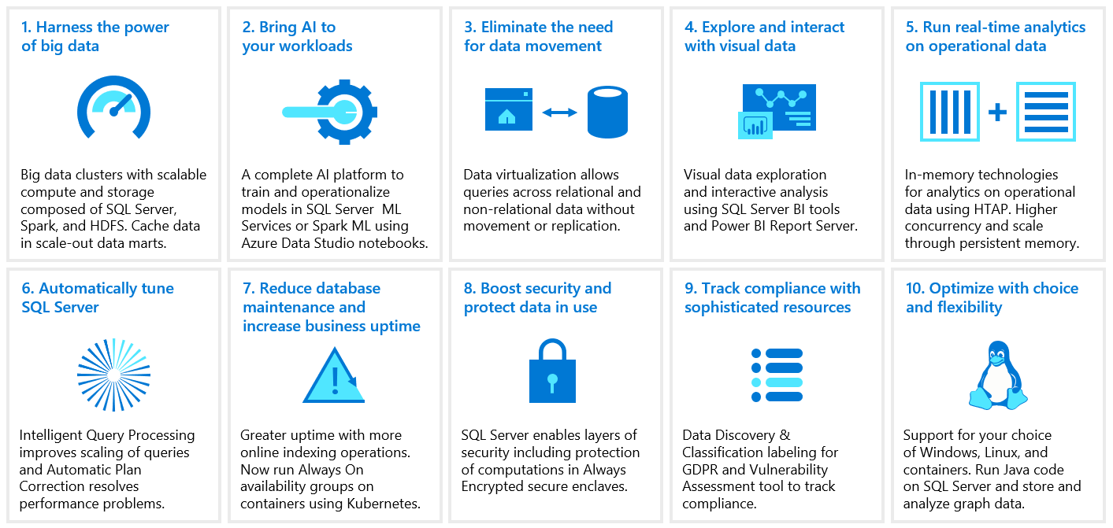
Top 10 features in sqL Server 2019
Notes:
Data Engineer seems to have different definitions depending on if you are talking about stictly data or data science.
Guess what, if you are the person people point at if there is somethign is wrong with data in your organization, guess what, you are a Data Engineer.
Wether you are on prem, in the cloud or some where in between, you are a data engineer

Slide 12

SQL Server 2019
Industry-leading performance and security, with intelligence over all your data
Intelligence over any data
Choice of platform and language
Industry-leading performance
Most secure over the last 8 years⁵
Insights in minutes and rich reports
+
#1 OLTP performance¹
#1 DW performance on 1TB², 10TB³, and 30TB⁴
Intelligent Query Processing
AI and Machine Learning over all data with the power of SQL and Apache Spark
T-SQL
Java
C/C++
PHP
Node.js
C#/VB.NET
Python
Ruby
The best of Power BI and SQL Server Reporting Services with Power BI Report Server
In-memory across all workloads
Most consistent data platform
Private cloud
1/10th the cost of Oracle
Public cloud
All TPC Claims as of 1/19/2018.
¹ http://www.tpc.org/4081; ² http://www.tpc.org/3331; ³ http://www.tpc.org/3326; ⁴ http://www.tpc.org/3321; ⁵ National Institute of Standards and Technology Comprehensive Vulnerability Database
Notes:
Couple of things in that 10 I want to highlight in the next few slides

Slide 13
SQL 2019 – Not just on premises any more
- Story about the Excel
Notes:
Data Engineer seems to have different definitions depending on if you are talking about stictly data or data science.
Guess what, if you are the person people point at if there is somethign is wrong with data in your organization, guess what, you are a Data Engineer.
Wether you are on prem, in the cloud or some where in between, you are a data engineer

Slide 14




Big data clusters deployed on Kubernetes, OpenShift, AKS
Control
Controller Svc
Proxy
Kibana
Grafana
Custom apps
Configuration Store (SQL Server)
Elastic Search
InfluxDB
BI
Analytics
Cluster
SQL
SQL Server master instance
External data sources
Compute pool
Directly read from HDFS
SQL Compute Instance
SQL Compute Instance
SQL Compute Instance
SQL Compute Instance
SQL Compute Instance
…
SQL Compute Instance
Application pool
Data pool
Storage pool
Application
SQL Datapool Instance
SQL Datapool Instance
Spark
SQL Server
Spark
SQL Server
Spark
SQL Server
…
HDFS Datanode
HDFS Datanode
HDFS Datanode
IoT data
Storage
Storage
Kubernetes pod
Node
Node
Node
Node
Node
Node
Node
Persistent storage
Notes:
Data Engineer seems to have different definitions depending on if you are talking about stictly data or data science.
Guess what, if you are the person people point at if there is somethign is wrong with data in your organization, guess what, you are a Data Engineer.
Wether you are on prem, in the cloud or some where in between, you are a data engineer

Slide 15







You don’t even have to move data
“It’s all about
Data Virtualization”
It all started with T-SQL against Hadoop
Query data where it lives using T-SQL
Compute engine integrated with SQL Server
Distributed, scalable query performance
Manual/deploy with SQL Server
Auto deploy/optimize with Big Data Clusters
Analytics
T-SQL
Apps
SQL Server
PolyBase external tables
ODBC
NoSQL
Relational databases
Big data
Excel
Cosmos DB
HDFS
Intelligence over all data
Notes:
Data Engineer seems to have different definitions depending on if you are talking about stictly data or data science.
Guess what, if you are the person people point at if there is somethign is wrong with data in your organization, guess what, you are a Data Engineer.
Wether you are on prem, in the cloud or some where in between, you are a data engineer

Slide 16

SQL Server 2019 serves as the hub for all your data
Legacy SQL Server
Azure SQL Database
Azure Cosmos DB
Legacy suppliers
Modern stock items
Mobile app orders
SQL Server 2019
Customers from acquisition
Accounts receivable
Order reviews
Intelligence over any data
Notes:
What does that look like?
Data Engineering here is not about moving data, but security and access
Whether it is on prem or in the cloud

Slide 17
Principles of Data Engineering
Notes:
Before we go too far into the tool
Lets cover the environment that SQL DW operates

Slide 18
Data Engineering Design Principles / best practices
The Data Must Always be correct and auditable
Document your code and design decisions
Design for Failure
Design for Process Insights
Design for Scale
Design for Change
Notes:
These are my design principles

Slide 19
Principles - 1 Data Must Always be correct and auditable
Notes:
These are my design principles

Slide 20
Principles – 2 Document your code and design decisions
Notes:
These are my design principles

Slide 21
Principles – 3 Design for Failure
Notes:
These are my design principles

Slide 22
Principles – 4 Design for Process Insights
Notes:
These are my design principles

Slide 23
Principles – 5 Design for Scale
Notes:
These are my design principles

Slide 24
Principle – 6 Design for Change
Notes:
These are my design principles

Slide 25
Data Engineering Design Principles / best practices
The Data Must Always be correct and auditable
Document your code and design decisions
Design for Failure
Design for Process Insights
Design for Scale
Design for Change
Notes:
These are my design principles

Slide 26
Demo 1 Azure Data Factory Sliding Window
Capture sequential updates to Azure Data Factory !!
Notes:
Before we go too far into the tool
Lets cover the environment that SQL DW operates

Slide 27

Cloud Scale Analytics
Ingest
Store
Prep
Serve
Reporting
Azure Data Factory
Azure Data Lake Storage
Azure Databricks
Azure SQL Data Warehouse
Power BI
Copy data from over 75 data sources
Industry leading performance
Fast, easy, collaboration Apache® Spark-basedTM analytics platform
Unlimited scale & performance
Get started in seconds
Drag-n-drop UI
POSIX-compliant, fine grained access control
Native integration with Azure services
Flexibility to fit your needs
Ask questions, get answers
Execute your SQL Server Integration Services packages in Azure
Tiered multi-modal storage
Enterprise-grade Azure security
Enterprise-grade DW at the click of a button
Access intelligence anywhere
Polybase
Notes:
Ingest and orchestrate data
Process and analyze it
Apply machine learning techniques
Enrich your analytics store
All of this, while maintaining the security, SLAs and governance that you would expect from an enterprise-class solution.

Slide 28
Where Did I start?
Gather
Ingest
Store
Prepare
Serve
Data Marts
SQL
Azure Databricks
Multiple Azure SQL Database instance
Azure
Integration
Runtime
PolyBase
Files
(Reports / Printouts)
Azure Data Factory
Azure Blob Storage
Azure SQL Data Warehouse
Power BI
Data Cubes
Azure Data Factory
Multiple Azure Analysis Services instances
Notes:
Data Engineer seems to have different definitions depending on if you are talking about strictly data or data science.
Guess what, if you are the person people point at if there is something is wrong with data in your organization, guess what, you are a Data Engineer.
Whether you are on prem, in the cloud or some where in between, you are a data engineer

Slide 29
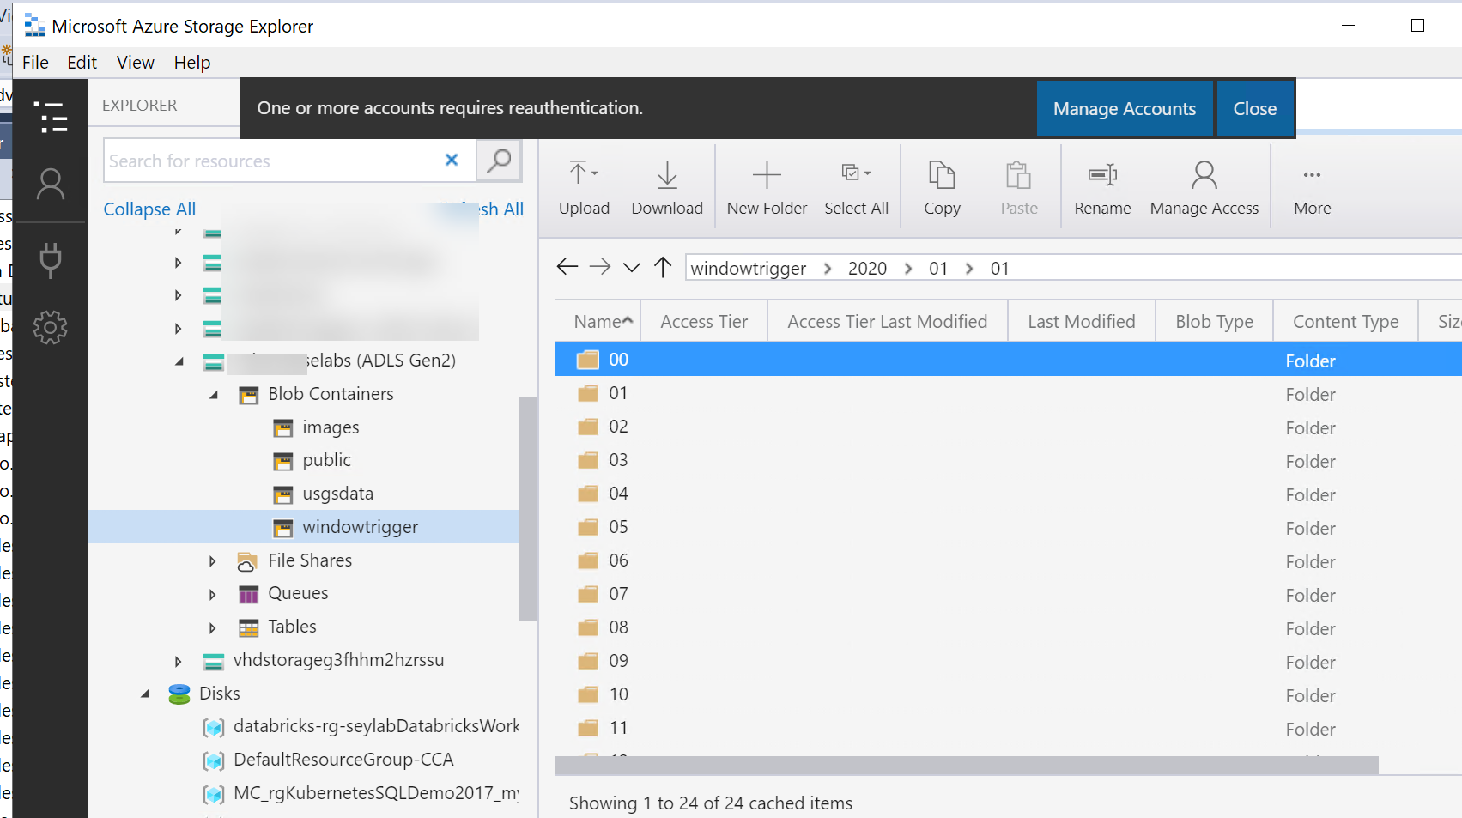
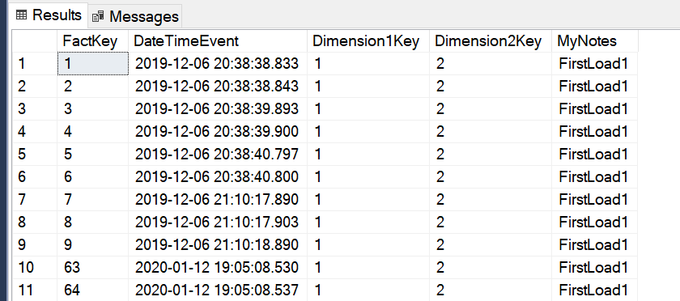
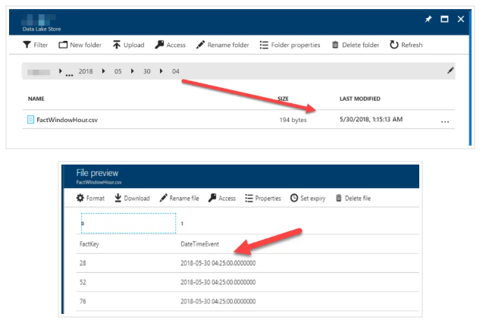
Demo 1
Notes:
These are my design principles

Slide 30
Demo 2 Data Virtualization
User data where it resides !!!
Notes:
Before we go too far into the tool
Lets cover the environment that SQL DW operates

Slide 31
You don’t even have to move data
“It’s all about
Data Virtualization”
It all started with T-SQL against Hadoop
Query data where it lives using T-SQL
Compute engine integrated with SQL Server
Distributed, scalable query performance
Manual/deploy with SQL Server
Auto deploy/optimize with Big Data Clusters
Analytics
T-SQL
Apps
SQL Server
PolyBase external tables
ODBC
NoSQL
Relational databases
Big data
Excel
Cosmos DB
HDFS
Notes:
Data Engineer seems to have different definitions depending on if you are talking about stictly data or data science.
Guess what, if you are the person people point at if there is somethign is wrong with data in your organization, guess what, you are a Data Engineer.
Wether you are on prem, in the cloud or some where in between, you are a data engineer

Slide 32
SQL Server 2019 serves as the hub for all your data
Legacy SQL Server
Azure SQL Database
Azure Cosmos DB
Legacy suppliers
Modern stock items
Mobile app orders
SQL Server 2019
Customers from acquisition
Accounts receivable
Order reviews
Notes:
What does that look like?
Data Engineering here is not about moving data, but security and access
Whether it is on prem or in the cloud

Slide 33
Demo 3 Azure Data Studio Notebooks
I’ve left the best Data Engineering tool to the last !!!!
Notes:
Before we go too far into the tool
Lets cover the environment that SQL DW operates

Slide 34
Azure Data Studio
Cross Platform – Windows, macOS, Linux
https://docs.microsoft.com/en-us/sql/azure-data-studio/download-azure-data-studio?view=sql-server-ver15
Notes:
Data Engineer seems to have different definitions depending on if you are talking about stictly data or data science.
Guess what, if you are the person people point at if there is somethign is wrong with data in your organization, guess what, you are a Data Engineer.
Wether you are on prem, in the cloud or some where in between, you are a data engineer

Slide 35
Azure Data Studio
References
Quickstart: Use Azure Data Studio to connect and query Azure SQL database -
https://docs.microsoft.com/en-us/sql/azure-data-studio/quickstart-sql-database?view=sql-server-ver15
https://docs.microsoft.com/en-us/sql/azure-data-studio/download-azure-data-studio?view=sql-server-ver15
Notes:
Data Engineer seems to have different definitions depending on if you are talking about stictly data or data science.
Guess what, if you are the person people point at if there is somethign is wrong with data in your organization, guess what, you are a Data Engineer.
Wether you are on prem, in the cloud or some where in between, you are a data engineer

Slide 36
SQL Server 2019 serves as the hub for all your data
Legacy SQL Server
Azure SQL Database
Azure Cosmos DB
Legacy suppliers
Modern stock items
Mobile app orders
SQL Server 2019
Customers from acquisition
Accounts receivable
Order reviews
Intelligence over any data
Notes:
What does that look like?
Data Engineering here is not about moving data, but security and access
Whether it is on prem or in the cloud

Slide 37





























































Platform Services
Security & Management
Hybrid
Cloud
Media & CDN
Application Platform
Data
Security Center
SQL
Database
Azure AD
Health Monitoring
Media Services
Media Analytics
Content Delivery
Network
Web
Apps
Mobile
Apps
SQL Data
Warehouse
DocumentDB
Portal
AD Privileged
Identity
Management
Azure Active
Directory
Integration
SQL Server
Stretch Database
Redis
Cache
Storage
Tables
Azure
Search
API
Apps
Cloud
Services
Azure AD
B2C
API
Management
BizTalk
Services
Domain Services
Service
Fabric
Notification
Hubs
Intelligence
Multi-Factor
Authentication
Logic
Apps
Service Bus
Functions
Cognitive Services
Bot Framework
Cortana
Backup
Automation
Developer Services
Analytics & IoT
Operational
Analytics
Compute Services
Scheduler
HDInsight
Machine
Learning
Stream Analytics
Container
Service
VM
Scale Sets
Visual Studio
Mobile
Engagement
Import/Export
Key Vault
Data
Catalog
Data Lake
Analytics Service
Data Lake Store
Store/
Marketplace
Batch
RemoteApp
VS Team Services
Xamarin
Azure Site
Recovery
Application
Insights
HockeyApp
IoT Hub
Event
Hubs
Data
Factory
Power BI
Embedded
VM Image Gallery
& VM Depot
Dev/Test Lab
StorSimple
Infrastructure Services
Compute
Storage
Networking
Virtual Machines
Containers
Blob
Queues
Files
Disks
Virtual Network
Load Balancer
DNS
Express
Route
Traffic Manager
VPN Gateway
App
Gateway
Datacenter Infrastructure
Notes:
SQL Operates in this environment – Part of the entire infrastructure
Security, Blob storage, ADF, AI, Storage, compute Over the infrastructure
The key point is that it is an integrated platform.
You have to know a little about a lot – at a minimum
We are covering SQL DW in this session.
Anyone getting their certifications?

Slide 38














Microsoft Azure BI & Analytics services portfolio
Devices | Device Connectivity | Storage | Analytics | Presentation & Action
` | IoT Hub | SQL Database | Machine Learning | App Service
 | Event Hub | Table/Blob Storage | Stream Analytics | Power BI
 | Service Bus | DocumentDB | HDInsight | Notification Hubs
 | External Data Sources | 3rd party Databases | Data Factory | Mobile Services
 |  |  | Data Lake | BizTalk Services
{ }
Notes:
This is the main service portfolio, we will see how these combine into different delivery models or as
we call them, Data Solution Architectures
Divided up into these areas. Devices, ……..

Slide 39

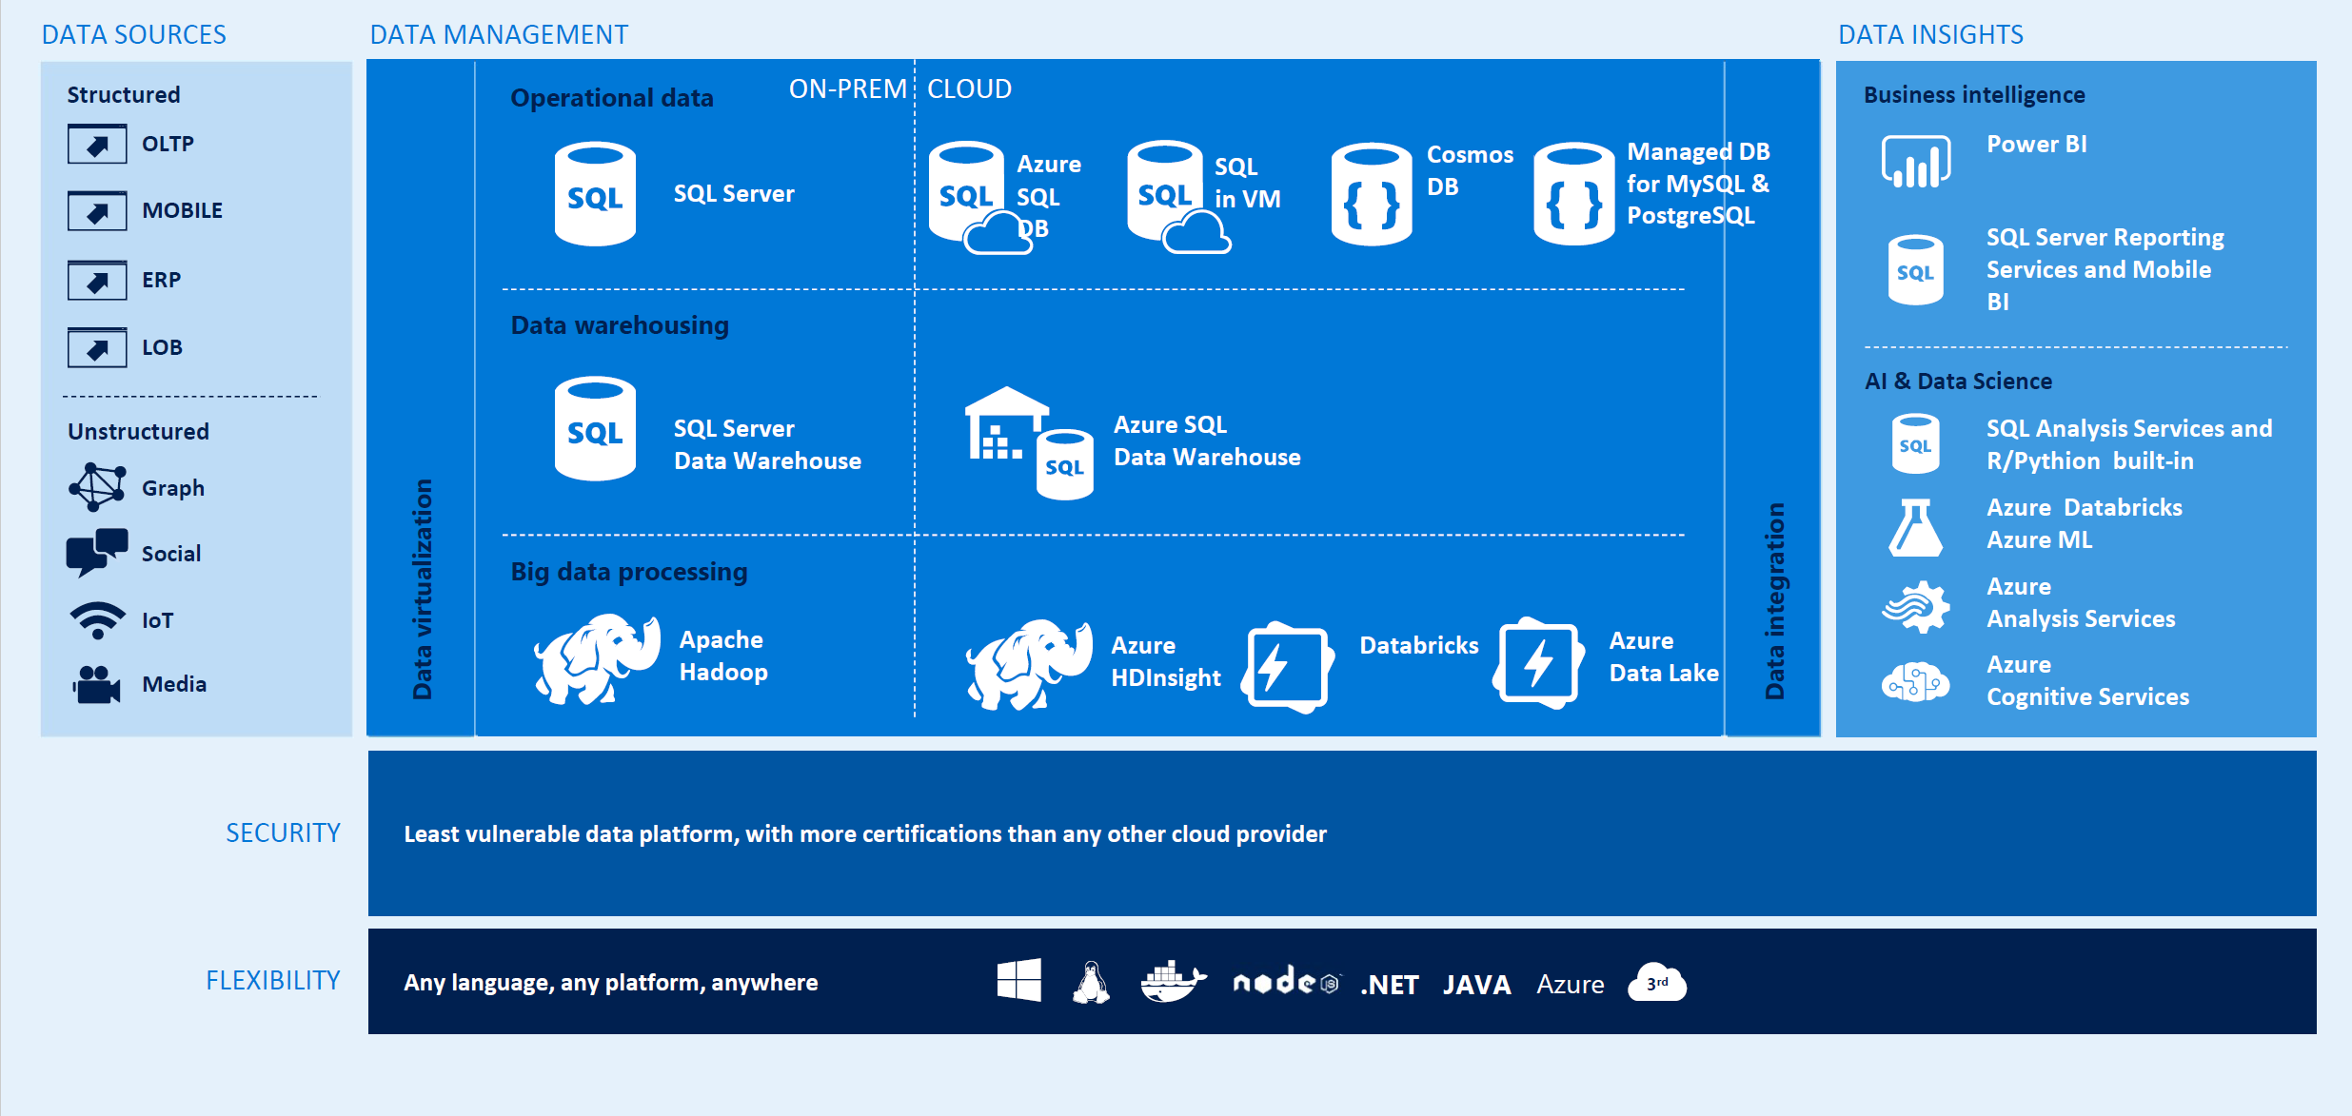

Azure and Data Estate Data View
Notes:
I like using this diagram with many of my presentations. The solution is some combination of the following into a Solution Architecture
We will combine them into the following “Pick List”
As you come up with solutions, you pick and choose from this list
This is limited.

Slide 40
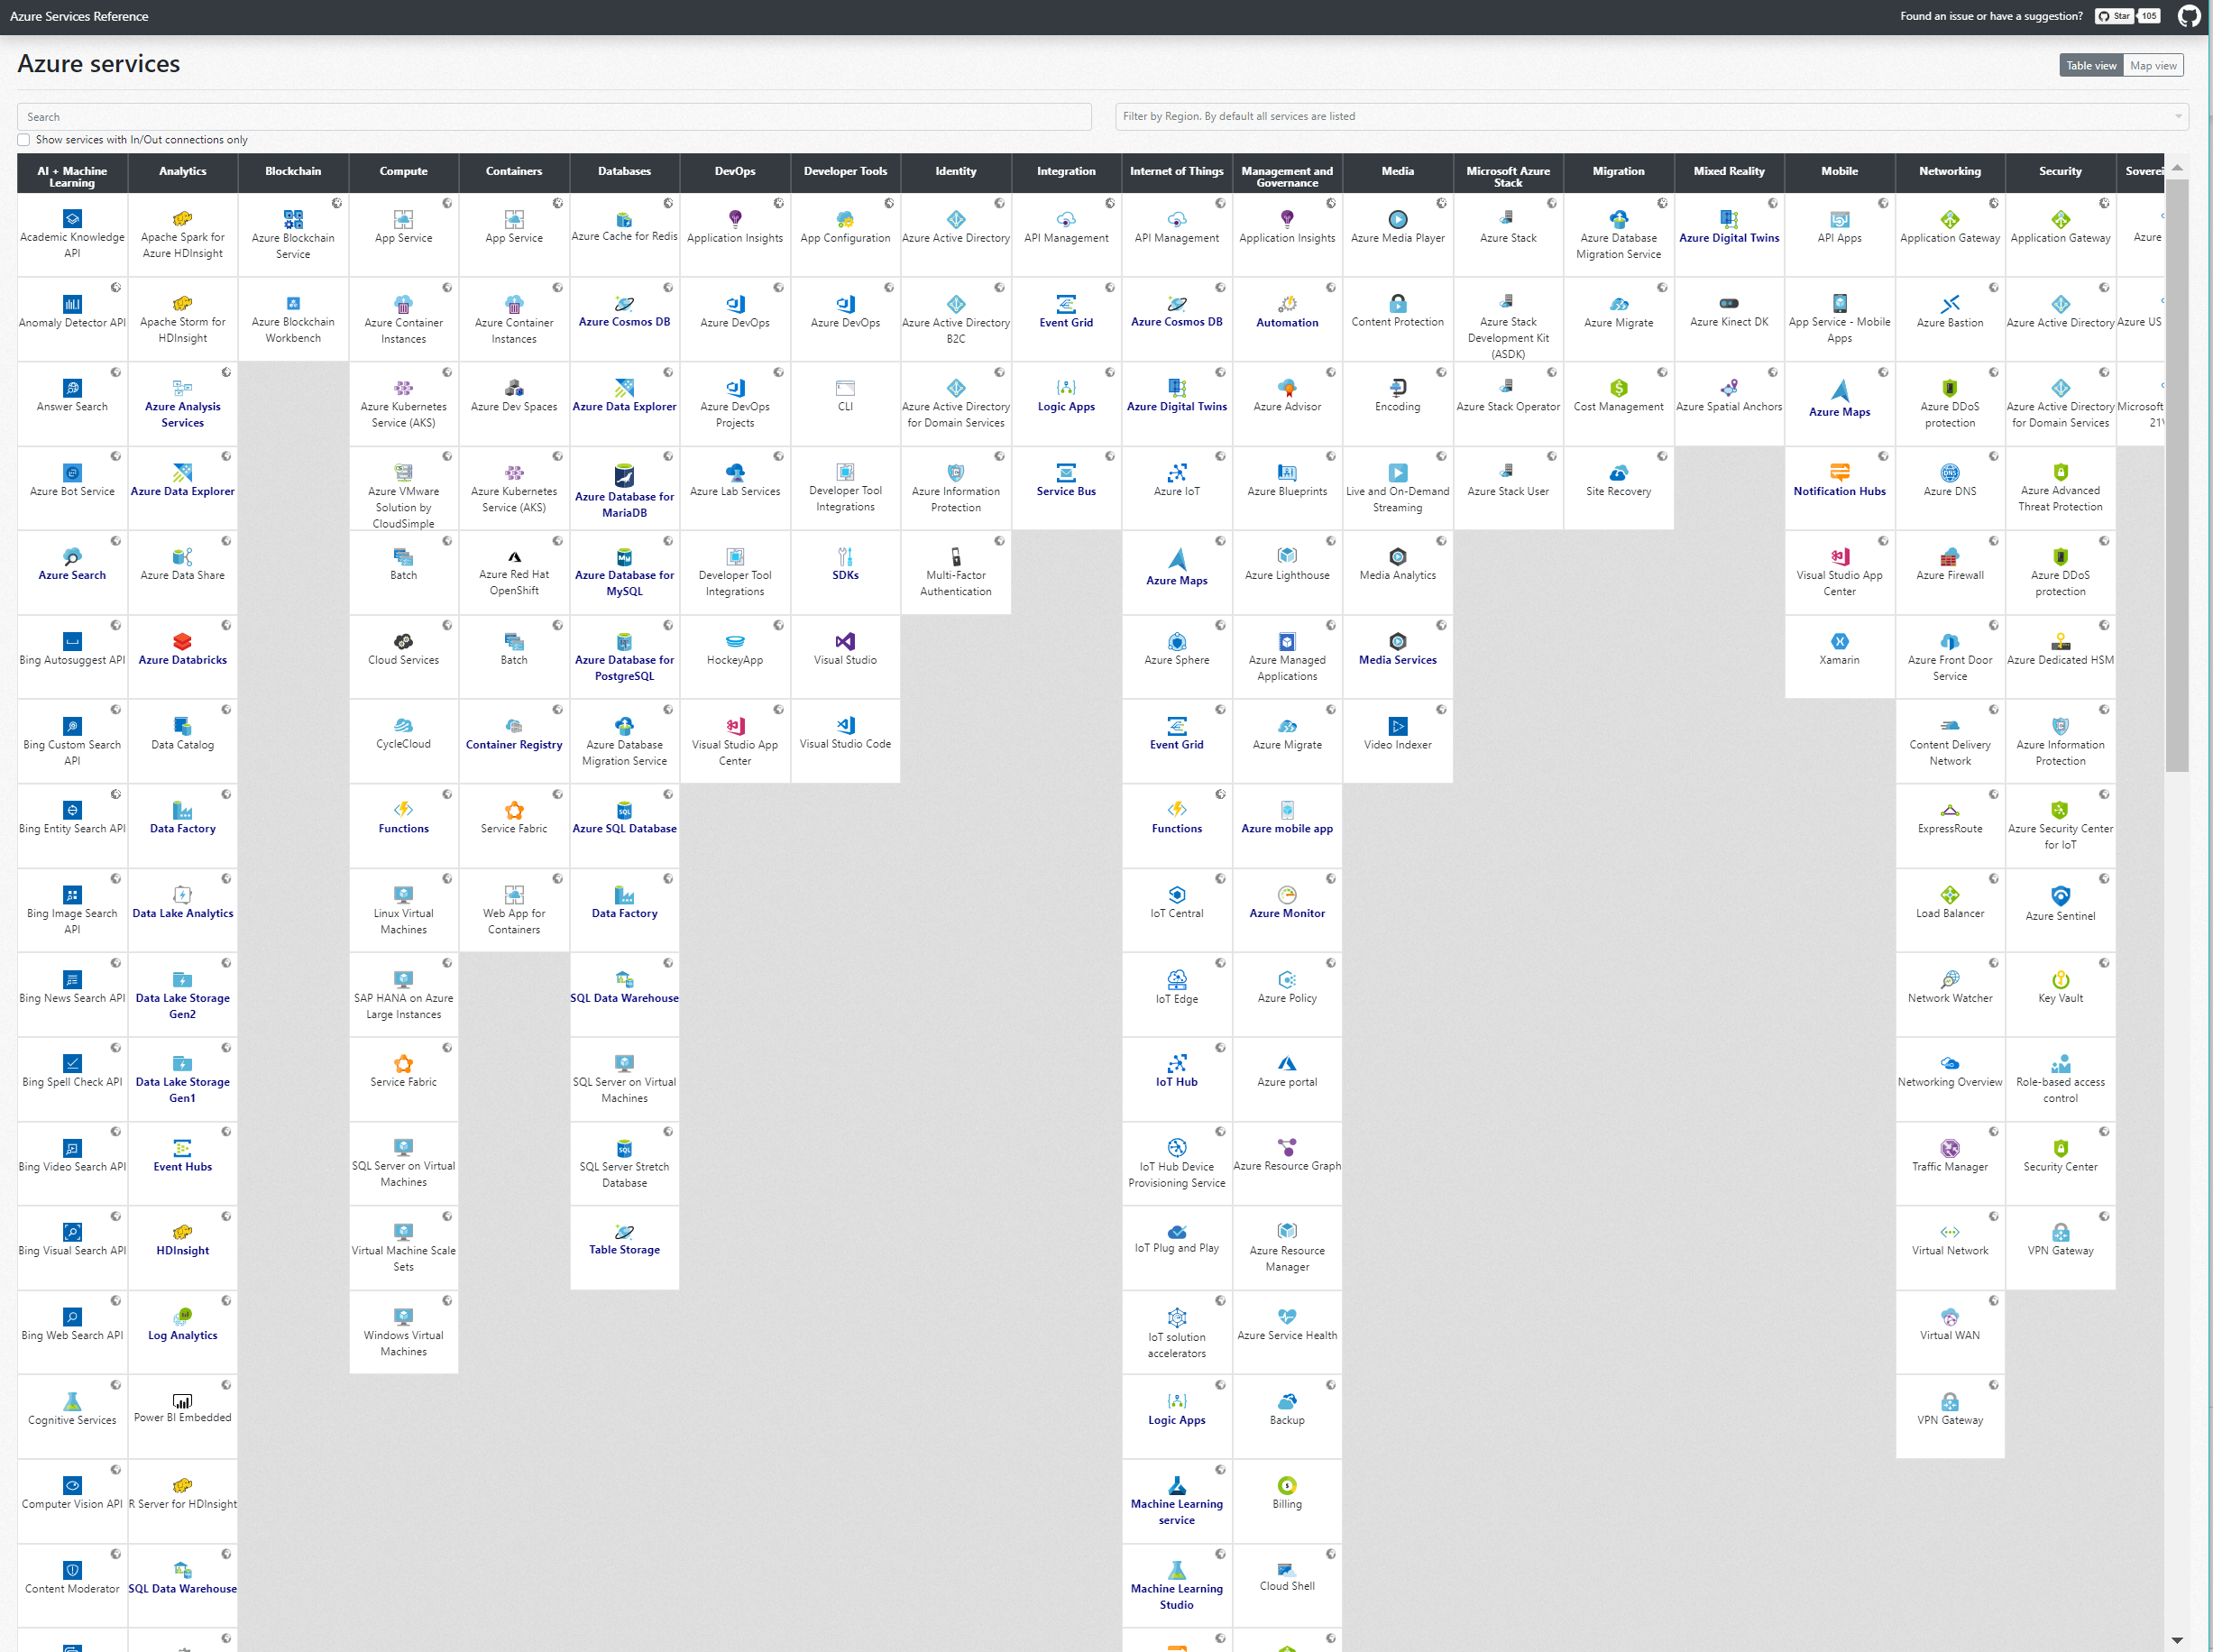
https://nnmer.github.io/azure-services-map/dist/
Anton Romanov -https://github.com/nnmer
Azure Services Map
Notes:
Even when you look at Azure, there are so many technologies, difficult to make the right choices
What do you choose?
DEMO – Go to site
Give credit to the community

